Slide 1
Chapter 11
Break Song

Slide 2
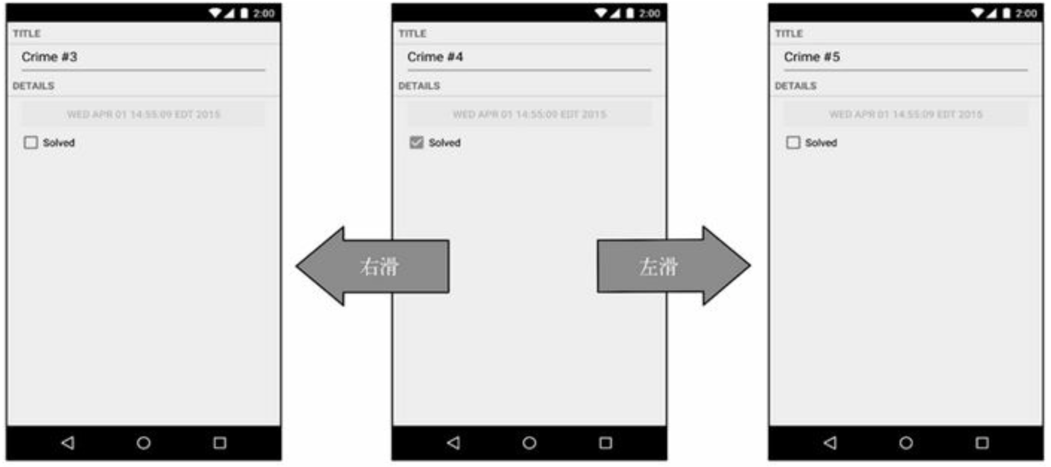

ViewPager / PagerAdapter

Slide 3
ViewPager XML
<android.support.design.widget.TabLayout
android:id="@+id/sliding_tabs"
android:layout_width="match_parent"
android:layout_height="wrap_content"
app:tabGravity="fill"
app:tabMode="fixed"
app:tabSelectedTextColor="@color/black"
app:tabTextAppearance="@style/CustomTabLayout"/>
<android.support.v4.view.ViewPager
android:id="@+id/viewpager"
android:layout_width="match_parent"
android:layout_height="0px"
android:layout_weight="1" />

Slide 4
Initial ViewPager
private void initView() {
FragmentPagerAdapter adapter = new InfoCounterPagerAdapter(getSupportFragmentManager(), InfoCounterActivity.this);
viewPager.setAdapter(adapter);
viewPager.setOffscreenPageLimit(2); //設定當前頁面任一側N個頁面會被暫存
tabLayout.setupWithViewPager(viewPager);
//set tab listener
tabLayout.addOnTabSelectedListener(new TabLayout.OnTabSelectedListener() {
@Override
public void onTabSelected(TabLayout.Tab tab) {
viewPager.setCurrentItem(tab.getPosition());
}});
}

Slide 5
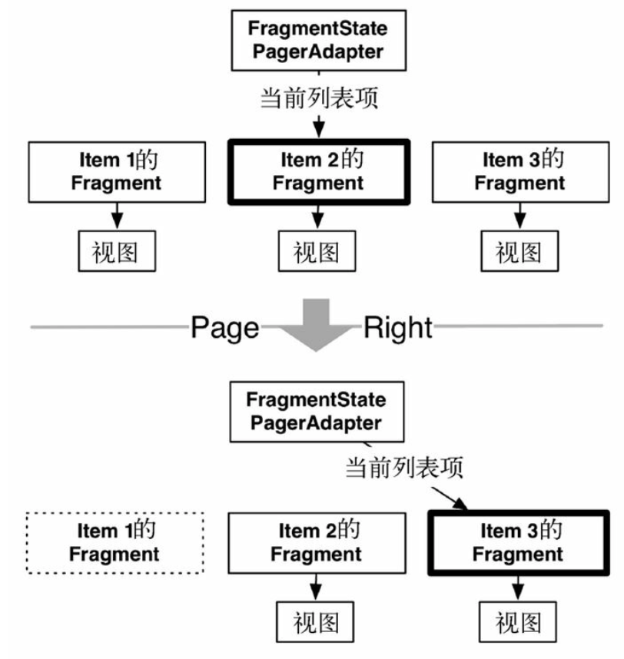
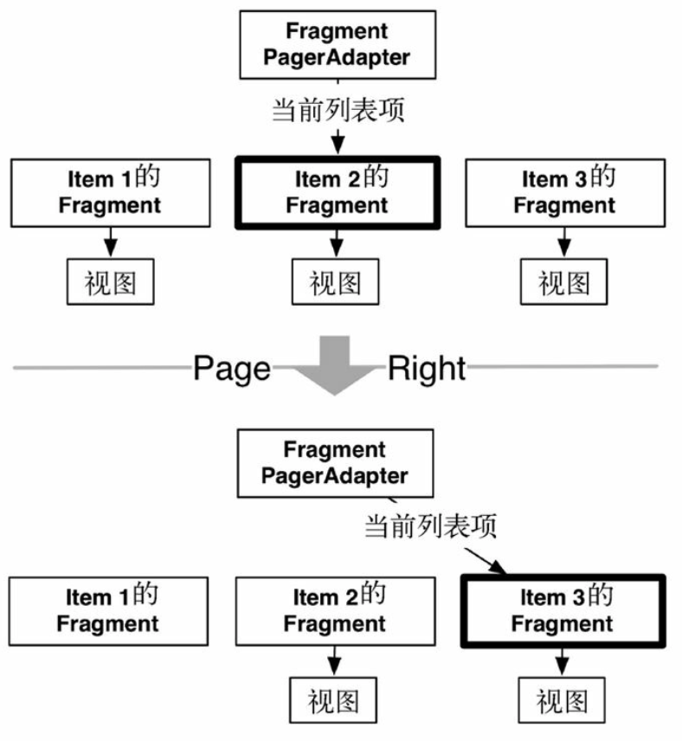
FragmentStatePagerAdapter FragmentPagerAdapter

Slide 6
PagerAdapter Difference
FragmentStateAdatper would destroy unuse fragment
FragmentStateAdatper restore destroy frament by using bundle obj to put/get data
FragmentStateAdatper saving more memory (Destroy unuse fragment)

Slide 7
Using tabLayout’s setupWithViewPager
tabLayout.setupWithViewPager(viewPager);
tabLayout.addOnTabSelectedListener(new TabLayout.OnTabSelectedListener() {
@Override
public void onTabSelected(TabLayout.Tab tab) {
viewPager.setCurrentItem(tab.getPosition());
}
@Override
public void onTabUnselected(TabLayout.Tab tab) {
}
@Override
public void onTabReselected(TabLayout.Tab tab) {
}
});

